Slide 1
Country Twenty-Three
Insights into a Bright Future
Notes:
This presentation showcases a collaboration between our analytics team and leaders from an aspiring nation, uncovering insights that could light the way to a more prosperous future. (We’ll refer to this country as County23 for discretion)

Slide 2
Outline
Executive Summary
Introduction
Methodology
Results
Conclusions
Notes:
The sections we will cover in this presentation are:

Slide 3
Executive Summary
The purpose of this analysis was to determine which economic factors most effectively predict high Gross Domestic Product (GDP) values, and lower poverty rates across countries. Using (EDA) exploratory data analysis and machine learning, the following key findings were identified:
Low poverty was most strongly associated with higher export values, a larger middle class, and increased spending on education
High GDP was best predicted by export values, followed by higher college enrollment and an ideal range of governmental transparency/accountability
This study enables Country23’s parliament an economic leaders to prioritize and align policy reforms with their national vision. It also provides and opportunity to consult or partner with peer countries that exemplify these outcomes
Notes:
The purpose of this analysis was to find factors that predict GDP and poverty rates using EDA and machine learning: What the study identified
- Poverty is most strongly associated with export values, size of the middle class, educational spending
- GDP is most strongly associated with export values as well, followed by college enrollment, and governmental transparency and accountability
These insights allows economic leaders and parliamentary officials to prioritize and align policy reforms with their national vision. As well as the opportunity to consult or partner with those countries aligned with that vision

Slide 4
Introduction
Country23 (for sake of discretion) and the surrounding region have experienced many years of political and economic instability. Following recent elections, foreign investment and a renewed commitment to reform, senior officials have requested an economic analysis to guide policy decisions aimed at improving national development. Country23, currently ranked in the lower third globally for GDP per capita and poverty levels, seeks actionable insights into the key factors driving these outcomes. This study will use robust, data-driven methods to identify and explain the economic drivers most critical to GDP growth and poverty reduction, with the goal of supporting informed discussions and effective decision-making among parliamentary leaders
Notes:
So how did we get here? Country23 has experienced years of instability. Following recent elections, some unexpected foreign investment and a renewed commitment to reform, senior officials contacted our analytics team and requested an economic analysis to guide policy decisions as they work to develop their country. They are currently in the lower third for both GDP and poverty and were particularly interested in the underlying factors associated with those outcomes. As a result, this study seeks to explain drivers most critical to GDP and poverty to inform discussions between decision makers and economic leaders

Slide 5
Methodology

Slide 6








Methodology
DATA COLLECTION
DATA WRANGLING
EXPLORATORY DATA ANALYSIS
PREDICTIVE ANALYTICS
Link to Country23’s github repository
Notes:
The steps used to complete the study were:

Slide 7
Data Collection

Slide 8


Data Collection
Find sources of economic data
Identify data relative to client request
IDENTIFY
Review and vet data with client
Manually download tables of interest
REVIEW
LOAD
Upload data to repository
Read dataframes into Jupyter notebook

Slide 9
Data Collection – Target Data
Gross Domestic Product per capita (df_gdp) [$US/Capita] - Monetary value of all goods and services produced within a country's borders - seen as a key indicator of economic health
Poverty Rate (df_pov) [%Population] - The percentage of the country's population that is at or below the poverty line as measured by the United Nations

Slide 10
Data Collection – Feature Dataframes (CPIA Scores)
CPIA (Country Policy and Institutional Assessment) is a rating system (1–6) used to evaluate how well a country’s policies and institutions support sustainable growth, poverty reduction, and effective use of development resources
CPIA – Business Regulation (df_reg) [Rating 1-6] - Assessment rating that measures how conducive a country’s policies are for private sector development (e.g. Ease of operating a business, Regulatory framework, Property rights)
CPIA - Gender Equity (df_gender) [Rating 1-6] - Assessment rating that measures the extent to which a country's policies promote gender equity and empower women
CPIA - Social Inclusion (df_social) [Rating 1-6] - Assessment rating that measures how well everyone, regardless of background, can participate fully in society
CPIA - Transparency Accountability and Corruption (df_tac) [Rating 1-6] - Assessment that measures how open governments operate, the mechanisms in place to hold public officials responsible, and the prevalence of corrupt practices in the public sector
CPIA - Public Resource Equity (df_pre) [Rating 1-6] - Assessment that measures how well governments allocates its public resources so that all segments of society benefits
CPIA - Trade (df_trd) [Rating 1-6] - Assessment rating that measures how supportive a country's trade policies are of integration into the global economy (e.g. Tariff barriers, Customs efficiency, Trade openness).
Notes:
Cpia – how well policies support sustainable growth in various area
Bus - support development of the private sector
Gen – promote gender equity and empower women
Inclusion – promote participation by all members of society
Transparency – support holding public officials accountable
Public Resource – allocates resources to all members of society
Trade – support integration into the global economy

Slide 11
Data Collection – Feature Dataframes (Financial)
Trade
Commodity Import Value (df_trdc) [$US/Capita] - Value of goods imported into a country divided by the population of that country
Commodity Export Value (df_trdc) [$US/Capita] - Value of goods exported out of a country divided by the population of that country
Income
Income distribution to 2nd Quintile (df_inc2q) [%Income] - Percentage of a country’s total income that is earned by the second lowest earning quintile (20% segment) of the population
Income distribution to 3rd Quintile (df_inc3q) [%Income] - Percentage of a country’s total income that is earned by the third lowest earning quintile (20% segment) of the population
Income distribution to 4th Quintile (df_inc4q) [%Income] - Percentage of a country’s total income that is earned by the fourth lowest (or 2nd highest) earning quintile (20% segment) of the population
Income distribution to 5th Quintile (df_inc5q) [%Income] - Percentage of a country’s total income that is earned by the highest earning quintile (20% segment) of the population
Income distribution to Top 10% (df_inc4q) [%Income] - Percentage of a country’s total income that is earned by the top 10% of the population

Slide 12
Data Collection – Feature Dataframes (Other)
Healthcare expenditures (df_health) [$US/Capita] – The value of a country’s total expenditures on healthcare related goods and services divided by that country’s population
Education expenditures (df_edu) [$US/Capita] – The value of a country’s total expenditures on educational goods and services divided by that country’s population
Gross College Enrollment (df_college) [%Population] - The number of a country’s population enrolled in secondary education divided by number of college aged citizens of that country
Ease of Doing Business (df_edb) [Rating 0 -100] – Measures how a country’s policy’s and practices support the ability to start, operate, and close a business
Population (df_pop) [Count] – The number of citizens in a country. This data will be used to convert other variable’s absolute values to per capita values

Slide 13
Data Wrangling

Slide 14
Data Wrangling – Overview
Clean
Merge
Reduce
Impute
Transform
Link to Data Wrangling Jupyter Notebook

Slide 15
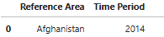
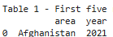
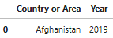
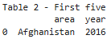
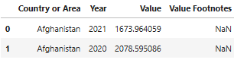
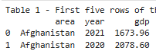
Data Wrangling – Clean Data (1 of 3)
The purpose of Data Wrangling to prepare disparate dataframes to be seamlessly merged into one dataframe for the purpose of future analysis
Remove white space characters
Lower case column names
Column names common across dfs
Remove non-informative columns
“\s\sBrazil\s”
“Brazil”
“Country or Area”
“area”
Notes:
Make sure to mention overriding purpose

Slide 16
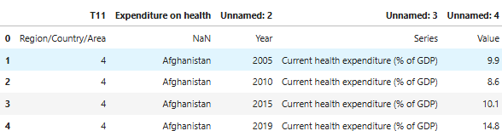
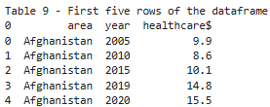
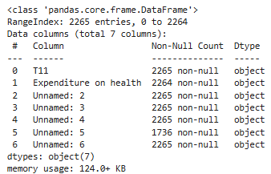
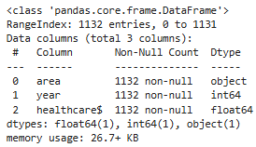
Data Wrangling - Clean Data (2 of 3)
Manage footers & headers where present
Adjust data types as needed
Adjust decimals for floats
area | year | comm_export_value
Brazil | 2014 | 56892.22356
area | year | comm_export_value
Brazil | 2014 | 56892.22

Slide 17
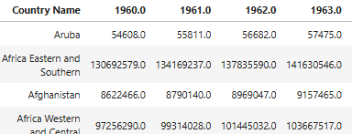
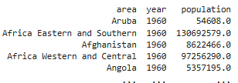
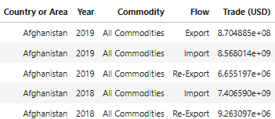
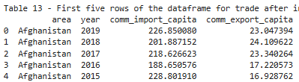
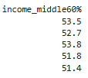
Data Wrangling – Clean Data (3 of 3)
Convert long form data into tidy form where necessary
Convert tidy form data into long form where necessary
Combine column data to make new features

Slide 18
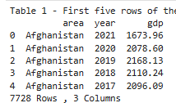
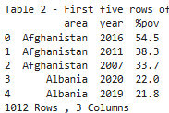
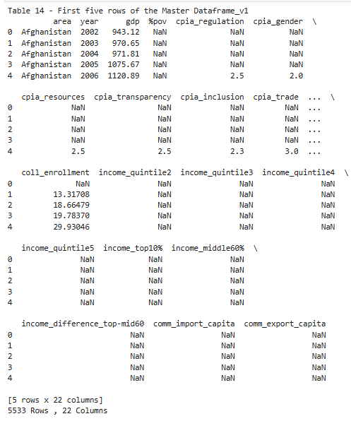
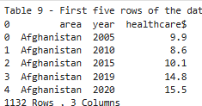
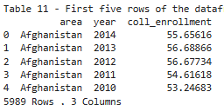
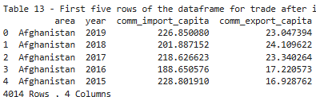
Data Wrangling – Merge Data
GDP_DF
Area
&
Year
All other Data frames

Slide 19
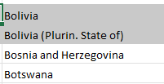
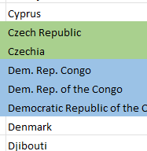
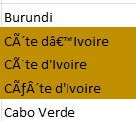
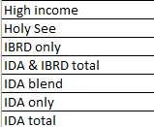
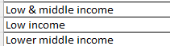
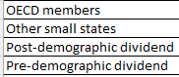
Data Wrangling – Additional Reduction and Maintenance
Standardize names of countries
Identify variations of same country
Run area names through dictionary to standardize those variations
Remove non-geographical records
Reassign region level redundant data to country level missing data
Add regional column (tidy to long form)
Impute regional data to their country’s missing data
Rename ‘area’ column to ‘country’
Drop region specific data
area | cpia_reg | healthcare$
Germany | NaN | 5.6
France | NaN | 6.6
Europe & Central Asia | 3.8 | NaN
Ghana | 3 | 4.2
D.R. Congo | NaN | NaN
Western & Central Africa | 2.2 | 4.5
country | region | un_region | cpia_reg | healthcare$
Germany | Central Europe | Europe & Central Asia | 3.8 | 5.6
France | Europe | Europe & Central Asia | 3.8 | 6.6
Ghana | Western Africa | Western & Central Africa | 3 | 4.2
D.R. Congo | Central Africa | Western & Central Africa | 2.2 | 4.5

Slide 20

Data Wrangling – Manage Missing Data (1 of 3)
Split single dataframe into GDP and Poverty dfs
Figure out some derivation of those dfs with:
Only 15% missing data in any feature
Still an acceptable number of records in df
Question to answer:
What minimum number of features per record having data would accomplish the above goal?
4 feature per record/row?, 5?...
Link to Missing Data Jupyter Notebook

Slide 21
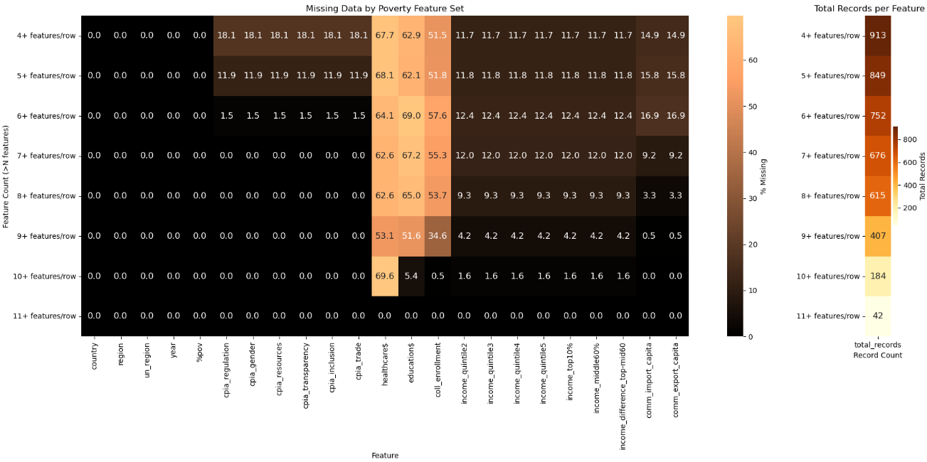
Data Wrangling – Manage Missing Data (2 or 3)
Chose df with minimum of 10 features/row with data. Drop healthcare from study
Notes:
Explain the chart before explaining the results!

Slide 22
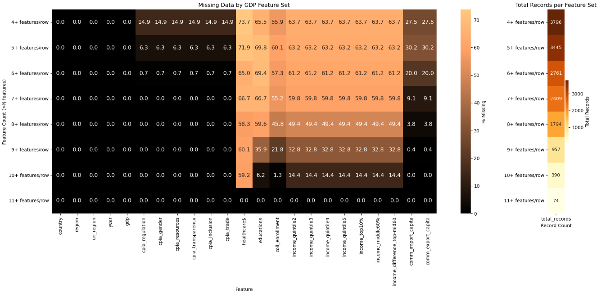
Data Wrangling – Manage Missing Data (3 or 3)
GDP Results Identical to Poverty
Drop healthcare expenditure feature
Impute the median (robust to outliers, and skewness) into missing values
Median approach based on histograms that can be viewed in missing data notebook link

Slide 23
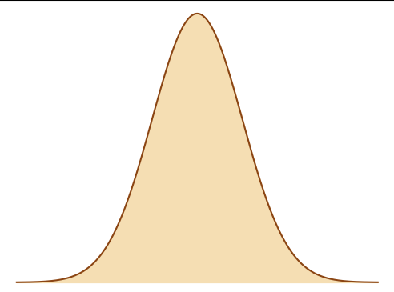
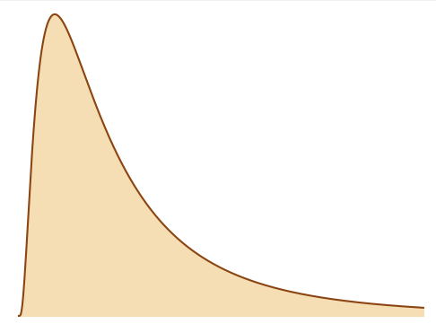
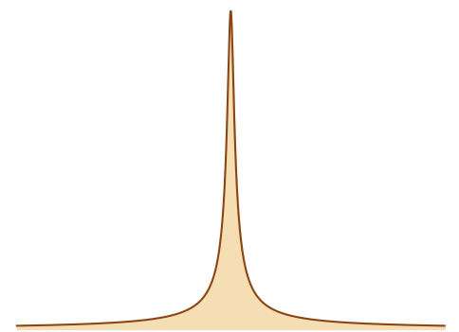
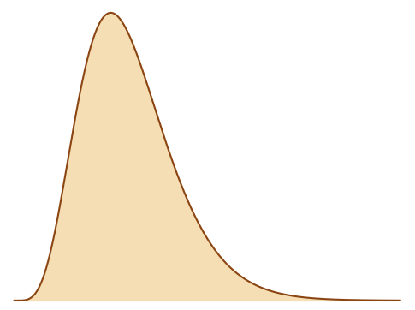
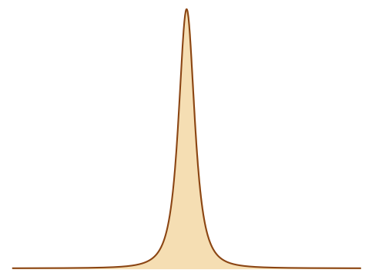
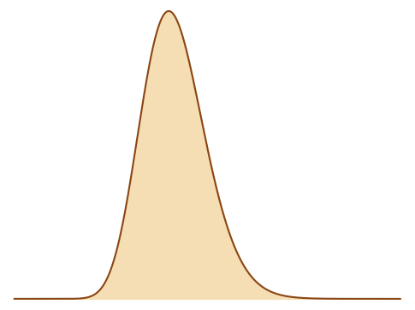
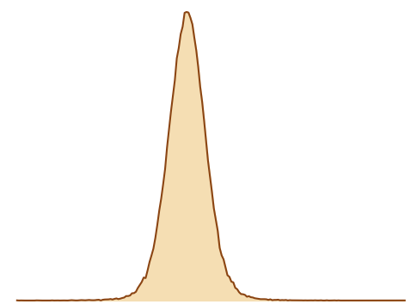
Data Wrangling – Transform Data
Regression models expect normality
Find out which (if any) transformation is needed
How skewness and kurtosis
Skewness > 1 or Kurtosis > 10:
Log transformation
Skewness > 0.5 or Kurtosis > 5:
Square root transformation
Skewness > 0.25 or Kurtosis > 3:
Box-Cox transformation
OR
OR
OR

Slide 24
Data Wrangling – Transformation Results
Transformation Results for Poverty Dataframe
Study Variables | Transformations
 | log | sqrt | boxcox | none
%pov | X
cpia_regulation | X
cpia_gender |  |  |  | X
cpia_resources |  | X
cpia_transparency |  | X
cpia_inclusion |  |  |  | X
cpia_trade |  | X
education$ |  |  |  | X
coll_enrollment |  |  |  | X
income_quintile2 |  |  |  | X
income_quintile3 |  |  |  | X
income_quintile4 |  | X
income_quintile5 | X
income_top10% | X
income_middle60% |  |  |  | X
comm_import_capita |  | X
comm_export_capita | X
Transformation Results for GDP Dataframe
Study Variables | Transformations
 | log | sqrt | boxcox | none
gdp | X
cpia_regulation |  |  | X
cpia_gender |  |  |  | X
cpia_resources |  |  | X
cpia_transparency |  | X
cpia_inclusion |  |  |  | X
cpia_trade |  | X
education$ |  | X
coll_enrollment |  |  |  | X
income_quintile2 |  |  |  | X
income_quintile3 |  |  |  | X
income_quintile4 |  | X
income_quintile5 | X
income_top10% | X
income_middle60% |  |  |  | X
comm_import_capita | X
comm_export_capita | X
Only minor differences between Poverty and GDP dataframes

Slide 25
Exploratory Data Analysis (EDA)

Slide 26



Exploratory Data Analysis Approach using SQL
GENERAL INFORMATION
RANKING
CHANGES AT THE EXTREMES
Link to Exploratory Data Analysis Jupyter Notebook

Slide 27
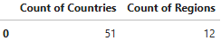
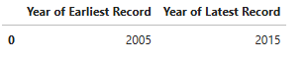
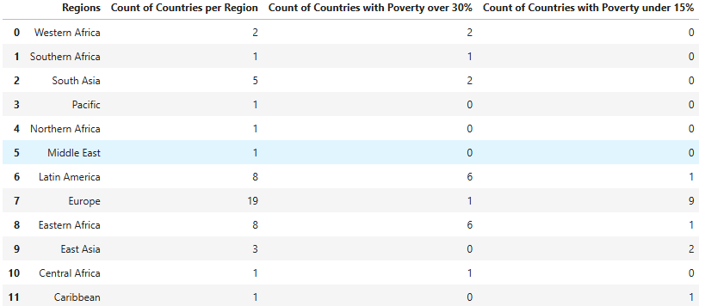
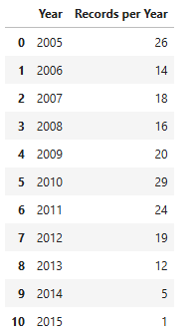
EDA – General Information about Poverty Dataframe
Number of Countries and Regions
Timespan of Study
Count of Countries in each Region with additional Poverty Information
Count of Records per Year
North America, and Australia have no records in poverty study
Europe has more than twice as many countries than next highest region
18% of poverty data is at the extremes (above 30% or below 15%)
80% of poverty data under 15% is from Europe and East Asia
84% of poverty data over 30% is from Africa and Latin America
Smaller number of records after 2012

Slide 28
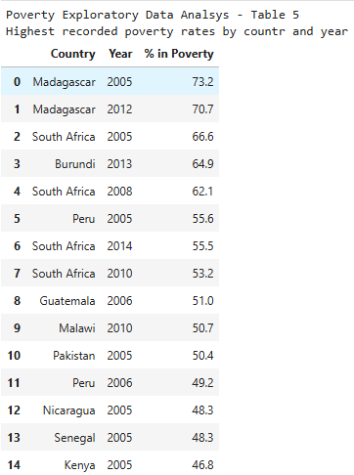
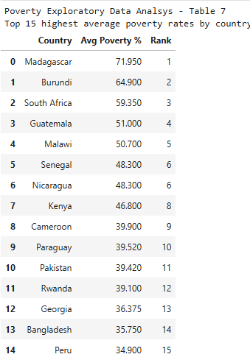
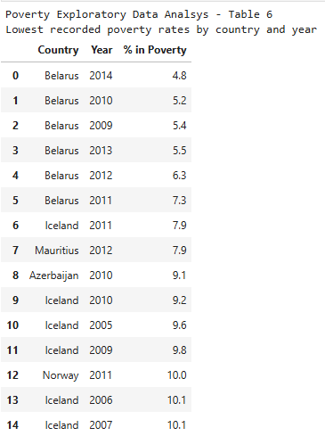
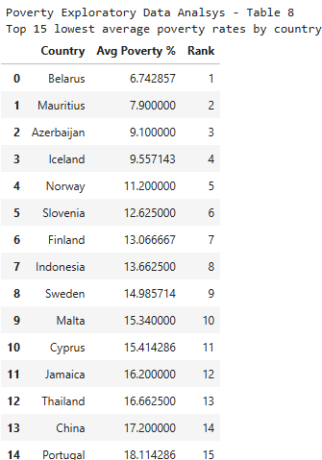
EDA – Countries with Highest and Lowest Poverty Rates
Recorded Years of Poverty
Average Poverty% (2005-2015)
15 Highest Recorded Years
Highest Avg Poverty% by Country
15 Lowest Recorded Years
Lowest Avg Poverty% by Country
Repeat Actors
Lowest %pov – Belarus?
1 out of 2 citizens
Vs 1 out of every 8

Slide 29
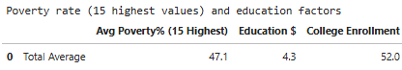
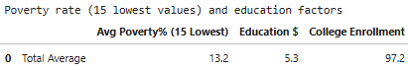
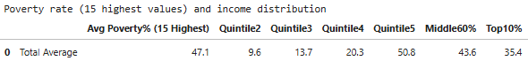
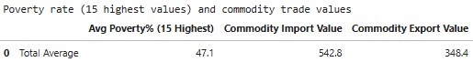
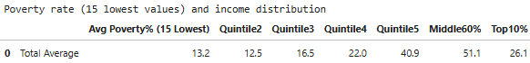
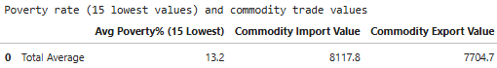
EDA – Fringe Poverty Values vs Feature Values
CPIA Scores
Education
2% Δ
0% Δ
3% Δ
3% Δ
+23% Δ
-3% Δ
8% Δ
-7% Δ
+87% Δ
Income
Trade Values
+16% Δ
+1,395% Δ
+2,114% Δ
Significant changes in feature values (especially trade)
Top 10% have smaller share of income for low poverty countries
-26% Δ

Slide 30




EDA – General Information about GDP Dataframe
Number of Countries and Regions
Timespan of Study
Count of Countries in each Region with additional GDP Information
Count of Records per Year
Europe has nearly twice as many countries as next highest region
21% of GDP data is at the extremes (above $10k and below $3k)
50% of GDP data above $10k is from Europe
80% of GDP data below $3k is from Africa
Large changes in available records year to year

Slide 31




EDA – Countries with Highest and Lowest GDP Values
Recorded years of GDP
Average GDP (2005-2015)
15 Highest Recorded Years
Highest Avg GDP by Country
15 Lowest Recorded Years
Lowest Avg GDP by Country
Repeat actors again
Top 15 is 36x wealthier than lowest 15

Slide 32






EDA – Fringe GDP Values vs Feature Values
CPIA Scores
Education
+6% Δ
+15% Δ
-7% Δ
+6% Δ
+11% Δ
+3% Δ
+3% Δ
+17% Δ
+248% Δ
Income
+8% Δ
+10,589% Δ
+28,500% Δ
Trade Values
-16% Δ
GDP Feature changes aligned with poverty feature changes in direction
Larger than expected changes in trade values
More people enrolled in college than there are college aged citizens in high GDP countries

Slide 33
Data Visualization

Slide 34

Visualization Approach
SPREAD OF DATA
MAGNITUDE BY LOCATION
CHANGE OVER TIME
RELATIONSHIPS BETWEEN VARIABLES
Link to Visualization Jupyter Notebook

Slide 35



Visualization – Box & Bubble Plot of Poverty by Region
Eastern Africa’s distribution spans the full range of overall Poverty distribution
Several regions relatively narrow distributions (SQL query analysis showed many regions with single datapoints)
Most of poverty data appears to be between 10% and 50%
Northern hemisphere countries show lower average poverty

Slide 36


Visualization – Bar and Line Chart of Poverty by Region
The top 4 regions with the highest mean poverty are in Africa
Europe and East Asia have the two lowest mean poverty rates
Most region’s poverty rates appear to decrease over study period
East & Southern Africa show large swing in 2011, then steady return to previous highs

Slide 37

Visualization – Scatter Plot of Poverty vs CPIA Scores
All plots appear similar in shape
Relationships appear mild if at all
?
?
?
?

Slide 38

Visualization – Scatter Plot of Poverty vs Income
All appear to have moderate correlation
3 positive, 4 negative
Also appears to be collinearity between them

Slide 39


Visualization – Scatter Plot of Poverty vs Trade & Education
Non-linear moderate negative relationship to poverty
Imports and Export plot looks identical – suspect collinearity
College Enrollment appears to have moderate negative relationship
Education expenditure is not as clear

Slide 40

Visualization – Heatmap of Poverty Feature Collinearity
Darker the color (correlation score closer to 1 or -1), more likely features are correlated to each other
All income related features correlated
Import, Exports correlated
CPIA Inclusion correlated to 3 of 5 CPIA features
Actions:
Drop all but middle-class feature as representative of income share
Drop import feature
Drop CPIA inclusion feature

Slide 41



Visualization – Box & Bubble Plot of GDP by Region
Several regional distributions with outliers
Most of data appear to be within the $5k – $30k range
Appears to be a larger disparity in Average GDP extremes with less transition from high to low than observed for Poverty

Slide 42


Visualization – Bar & Line chart of GDP by Region
Expected inverse pattern in regions compared to mean Poverty
Three clusters of trend lines:
Europe with Middle East/North Africa
Latin America with East Asia/Pacific
West/Central Africa and South Asia
East/South Africa moves b/w the bottom two

Slide 43

Visualization – Scatter Plot GDP vs CPIA Scores
Most of plots appear centrally oriented like a histogram
Gender – mild positive relationship?
?

Slide 44

Visualization – Scatter Plot of GDP vs Income
111
Appears to have non-linear moderate relationships to GDP
3 positive, 4 negative
Many plots appear identical – suspect collinearity
111

Slide 45


Visualization – Scatter Plot of GDP vs Trade & Education
Trade features have strongest visual correlation thus far between feature and target.
Suspect collinearity here as well
Education expenditures appears to show at least mild correlation to GDP
College enrollment appears almost as strongly correlated to GDP as the trade features

Slide 46

Visualization – Heatmap of GDP Feature Collinearity
Same collinearity as seen between Poverty features
Actions for GDP dataframe:
Drop all but middle-class feature as representative of income share
Drop import feature
Drop CPIA inclusion feature

Slide 47
Predictive Analytics

Slide 48






Predictive Analytics - Preprocessing
Separate target from features
Normalize features to neutralize unit bias
Create categorical target data
Flexibility to use discriminant models also
Split datasets into train and test sets
1
4
2
Feature | Value
cpia_gender | 2.5
income_middle60% | 29.5
Feature | Value
cpia_gender | 4.7
income_middle60% | 5.8
3

Slide 49





Predictive Analytics Approach – Training & Testing
STEPS FOR EACH MODEL
TRAIN AND CROSS VALIDATE TRAINING DATA
PREDICT UNSEEN TEST DATA
EVALUATE THE MODELS PERFORMANCE
MODELS IN STUDY
REGRESSION MODELS
LINEAR / POLYNOMIAL
SUPPORT VECTOR REGRESSION
DISCRIMINANT MODELS
LOGISTIC REGRESSION
SUPPORT VECTOR CLASSIFIER
TREE MODELS
DECISION TREE
RANDOM FORREST
Link to Poverty Machine Learning Jupyter Notebook
Link to GDP Machine Learning Jupyter Notebook

Slide 50


Predictive Analytics - Model Evaluation
The following metrics will be evaluated for each model
Regression Models (Continuous data)
R^2 - Tells us how much of the change in the outcome (target) is explained by the changes in the input (feature) variables
Discriminant Models (Classification data)
Accuracy – Tells us the overall correctness of the model (how often it gets the prediction right)
Precision – Tells us how well the model predicts the positive class (avoids model concluding there’s an impact when in fact there is not)
Recall – Tells us how well the model identifies the actual positive class (avoids model concluding there is no impact when in fact there is)
F1 Score – Tells us the balance between Precision and Recall (harmonic mean)
AUC – Tells us how well the model separates the classes (overall discriminative power. Helps when comparing different models)
Given the client’s objective they prioritize Precision, followed by Accuracy
Regression Example
Classification Example

Slide 51

Predictive Analytics – Poverty Model Comparison
Binary-Class Random Forrest is the best performing model for predicting Poverty, with highest Precision and Accuracy

Slide 52


Predictive Analytics – Poverty Feature Importance
The most important features from the best performing model are commodity exports, income to the middle class, education expenditures
Step-change difference b/w those features and the remaining
Shows inverse relationship
As input (feature) variable increases, Poverty (target) value goes down

Slide 53

Predictive Analytics – GDP Model Comparison
Multi-Class SVM Classifier is the best performing model for predicting GDP with highest Precision and Accuracy

Slide 54


Predictive Analytics – GDP Feature Importance
The most important features from the best performing model are commodity exports, followed by college enrollment and government transparency
Step-change difference trade and other inputs
Direct relationship with trade and college enrollment
Transparency relationship not as clear – appears to imply a range that’s good enough (afterwards law of diminishing returns)

Slide 55
Results & Conclusion

Slide 56
Results from Poverty Data
Data Imputation and Coverage
82% of records dropped enabling imputation
Major economies US, Canada, Australia absent from study as a result
Extreme Poverty Rates
18% of countries had poverty >30% or <15%
Top 15 poorest countries: avg poverty 47%
Top 15 least poor: avg poverty 13%
Feature Change Comparing Poverty Extremes (Top 15)
CPIA score: No change
Education spending: Up 23%
College enrollment: Up 87%
Middle class income: Up 16%
Top 10% income: Down 26%
Trade Activity: Up > 1,000%
Feature Correlations
All income features correlated
Commodity imports >>> exports
CPIA inclusion >>> gender, resources, regulation
Model Performance
Binary Random Forest Classifier
Precision and Accuracy 96%
Top predictors:
Commodity trade
Middle class size
Education spending

Slide 57
Results from GDP Data
Data Imputation and Coverage
91% of records dropped enabling imputation
Major economies US, Canada absent from study as a result
Extreme GDP Rates
21% of countries had GDP >$10k or <$3k
Top 15 wealthiest countries: avg GDP $49,927
Top 15 least wealthy: avg GDP $1,384
Feature Change Comparing GDP Extremes (Top 15)
CPIA score: Up 3%
Education spending: Up 17%
College enrollment: Up 287%
Middle class income: Up 8%
Top 10% income: Down 16%
Trade activity: Up > 10,000%
Feature Correlations
All income features correlated
Commodity imports >>> exports
CPIA inclusion >>> gender, resources, regulation
Model Performance
Multi-Class Support Vector Machine Classifier
Precision and Accuracy 96%
Top predictors:
Commodity trade
College enrollment
Governmental Transparency & Accountability

Slide 58
Conclusion
Models accurately predicted both poverty, and GDP, offering valuable guidance for Countr23’s policy decisions
Commodity trade and education emerged as the most influential factors in the study for both target outcomes, and size of the middle class was most critical to poverty
Government transparency was a significant predictor of GDP, though its non-linear relationship calls for deeper study
Collinearity observed amongst specific trade and income variables – further analysis recommended
Healthcare’s impact on the economy could not be determined due to lack of data; additional data collection and analysis are recommended

Slide 59
Thank you!

